Slide 1

Wildfire Fire Risk Prediction and Detection using Machine Learning in San Diego, California
Ashima Malik, Nasrajan Jalin, Shalu Rani, Priyanka Singhal, Supriya Jain, Jerry Gao
San Jose State University, San Jose, United States

Slide 2
Introduction
Wildfires are one of the most dangerous and common natural disasters that we encounter every year.
Uncontrolled wildfires not only cause damage to the environment and disrupt the ecological balance and cause significant loss to life and property.
A combination of various factors such as dry vegetation, gusty wind, terrain, weather, etc., further aggravates the situation.
With so much impact on social and economic factors, it becomes necessary to build a near real-time solution for predicting and controlling wildfires.
According to the recent wildfire survey, most of the wildfire emergency systems still use conventional wildfire detection and prediction approaches.
A myriad of research papers has been published addressing wildfire detection and prediction by using mathematical and statistical methods. Still, these models have a lot of limitations such as limited parameters, low accuracy of risk prediction, the complexity of equations, and lack of real-time decision-making processes.
Therefore, we aim to include different parameters such as fire history, weather, remote sensing, and satellite data to improve the accuracy of fire risk prediction and detection models.

Slide 3
Problem Statement
Problem - ‘Why’?
Wildfires are the most destructive and dangerous accidents.
3000+ lives lost, $23 billion property damage every year.
Wildfires are both difficult to fight and predict.
Existing Solutions
Existing solutions only use one type of dataset to predict fire.
Not efficient models to detect fire spread patterns.
Our Research
Machine learning and Deep-learning techniques for fire risk prediction and detection models.
Used fire history, weather, remote sensing, and satellite data to improve the accuracy of fire risk prediction and detection models.

Slide 4
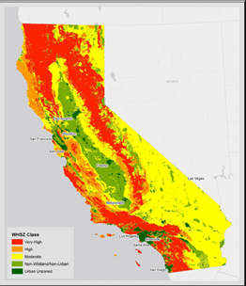
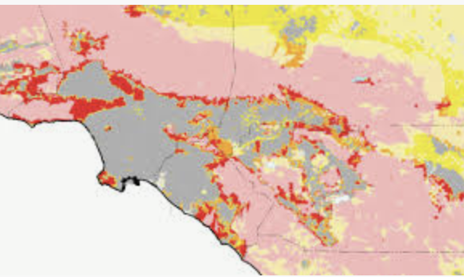
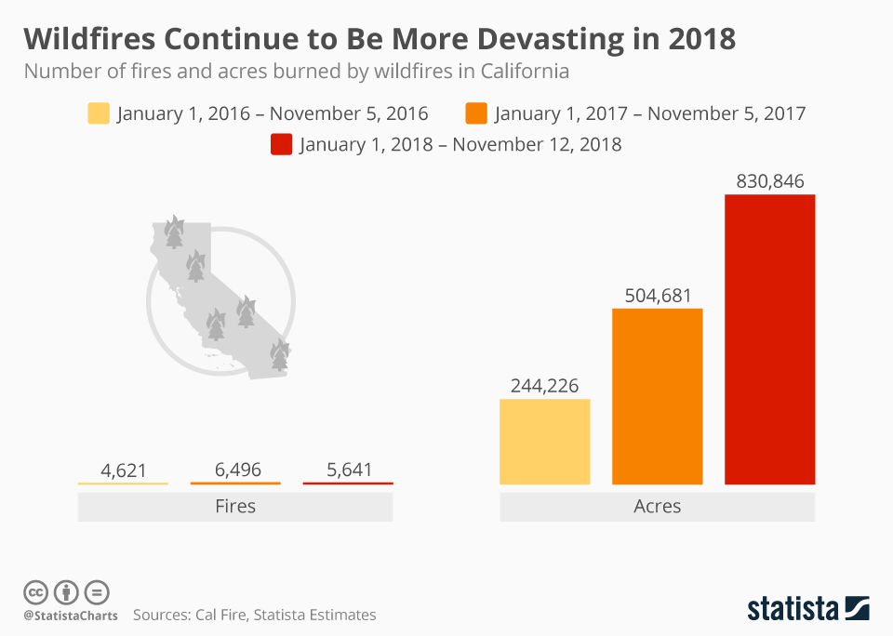
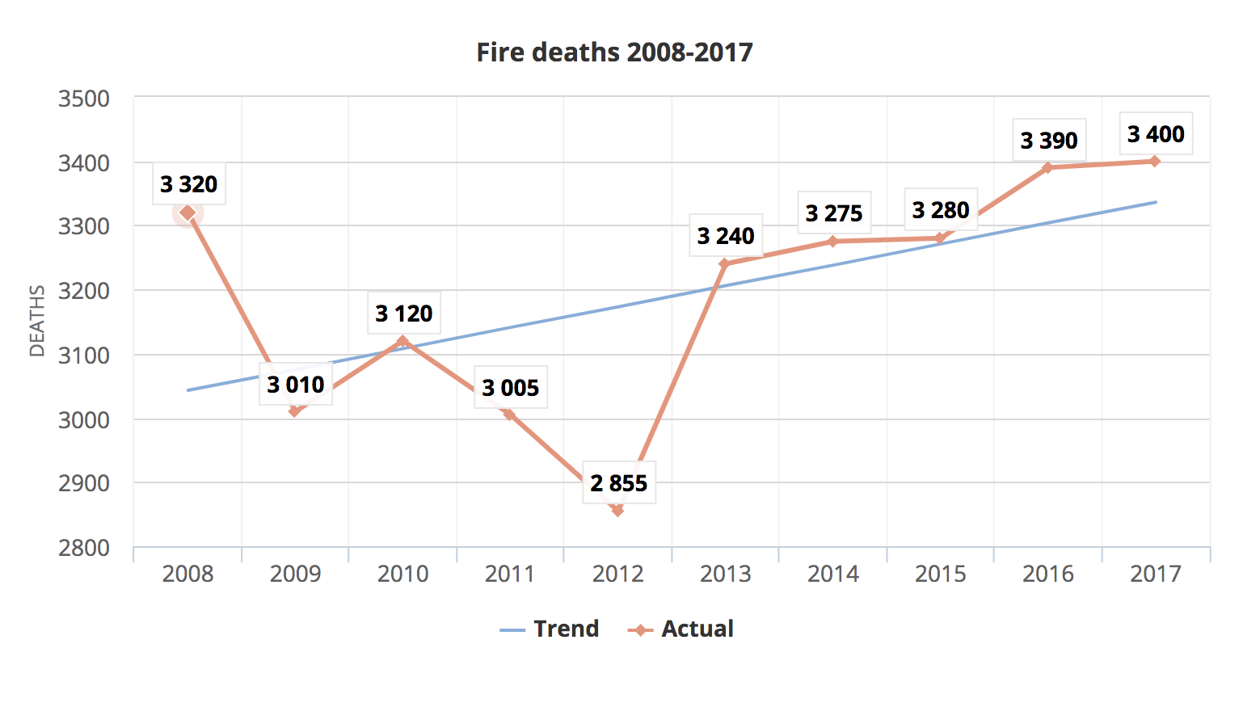
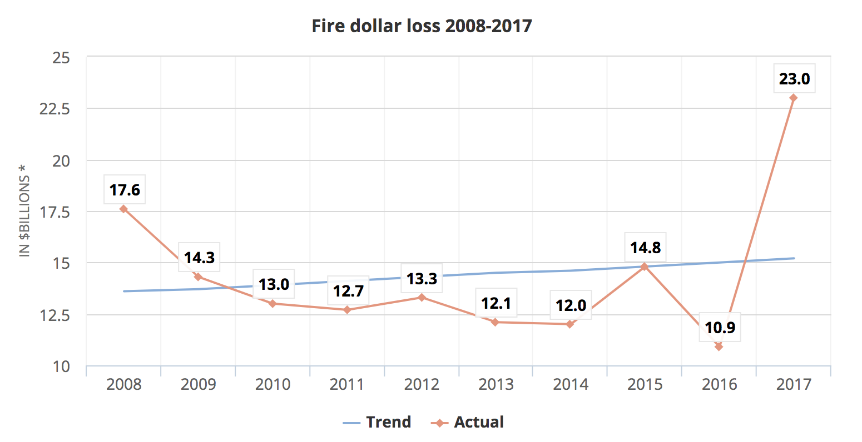
Motivation
Fig. in Map shows the active fires in Southern California
Loss of Money
Damage to Property
Damage to Lives
Frequent large wildfires are constant threat to California

Slide 5
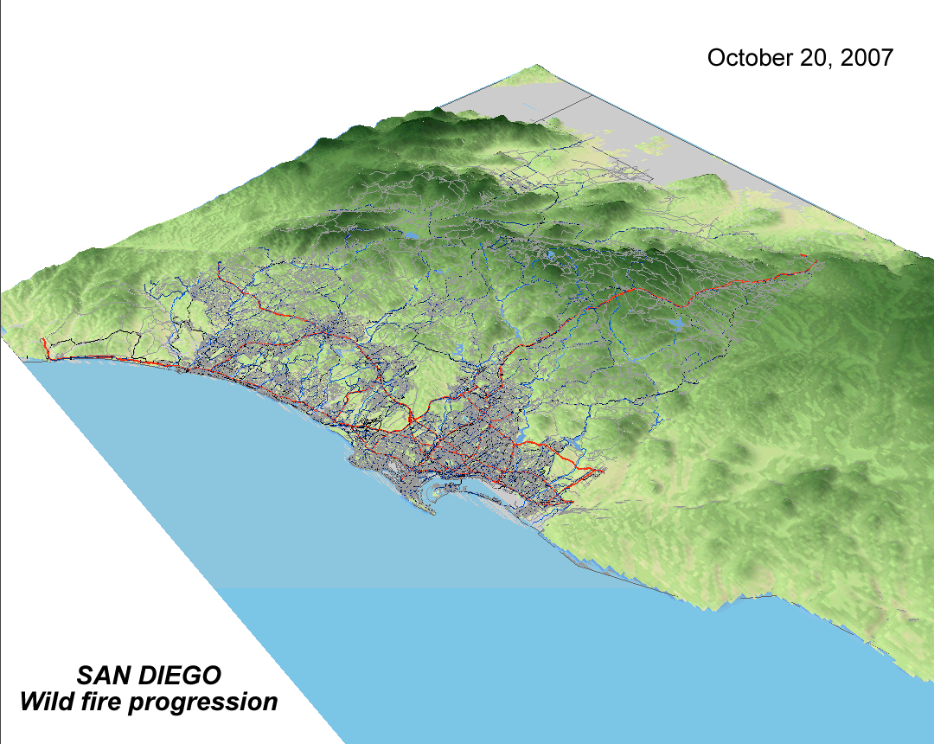
Solution
Fire Risk Prediction
Fire Detection
http://worldlywise.pbworks.com/w/page/26474623/The%20causes%20and%20effects%20of%20wildfires%20and%20how%20people%20prepare%20for%20and%20respond%20to%20them

Slide 6
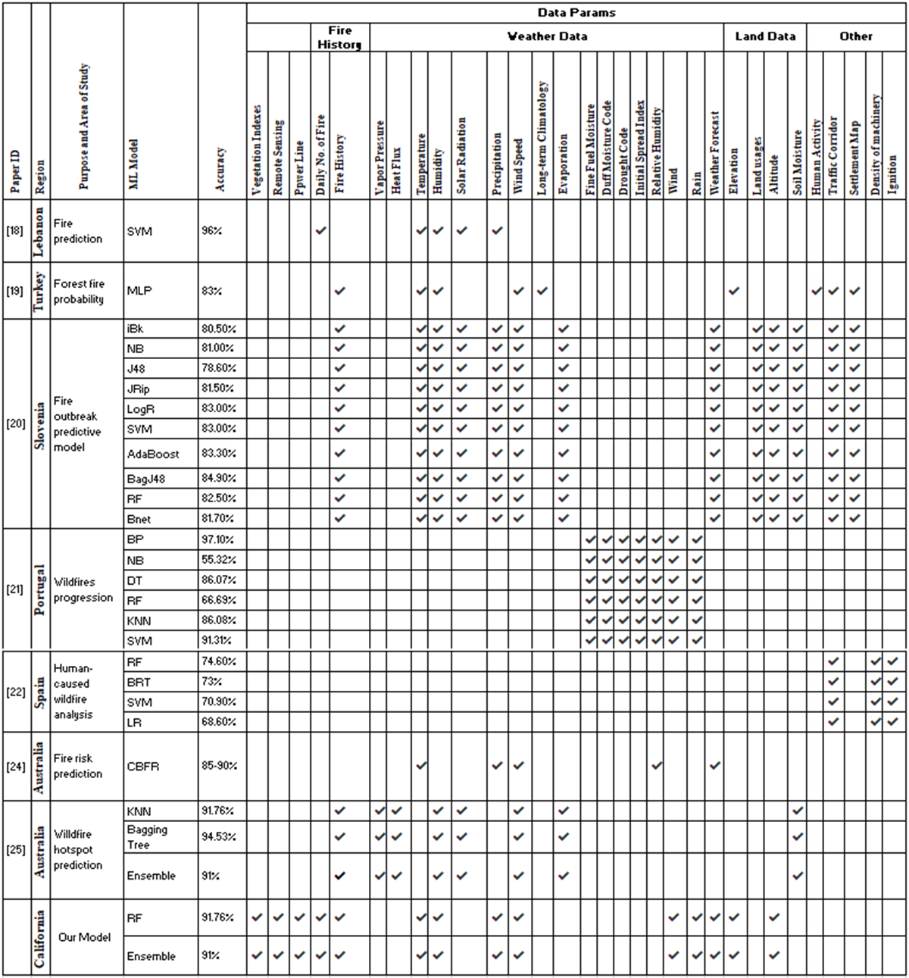
Related Work

Slide 7
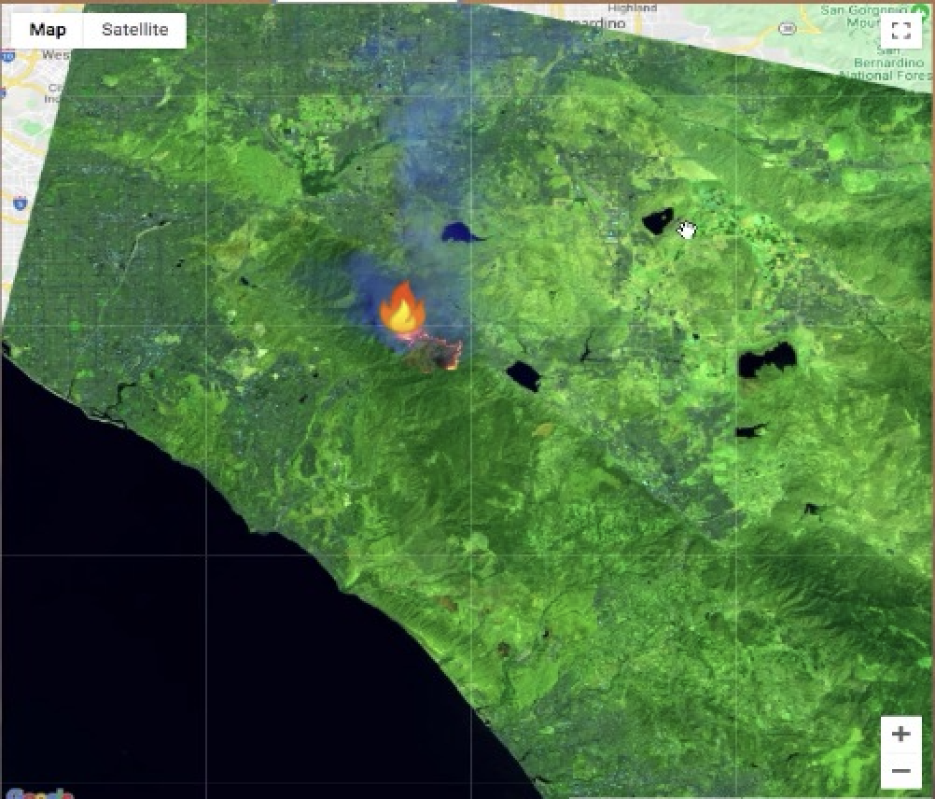

Study Area
San Diego County and surrounding forest regions
Region 1 - San Diego County
Min Lat - 34.65321 N
Max Lat - 32.54672 N
Min Long - 117.9024 W
Max Long - 116.03124 W
Region 2 - Fire prone zone - outside San Diego
Weather Conditions
Avg Temperature - 60 - 70 º F
Max Wind speed - 24 - 30 mph
Relative humidity - low
Strong Santa Ana winds
Past fire incidents
Creek Fire (Dec 2017)
Rye Fire (Dec 2017)
Rye Fire
Creek Fire
Minimum Latitude - 34.65321 N
Maximum Latitude - 32.54672 N
Minimum Longitude - 117.9024 W
Maximum Longitude - 116.03124 W
Fig. Area of interest for Fire History (San Diego, California)

Slide 8
Data Sources
Data | Sources
Fire History | Fire and Resource Assessment Program (FRAP), CAL Fire, United States Forest MSDA Project, Service region, Bureau of Land Management, and National park service
Weather | NCEO (National Center for Environmental Information)
Remote Sensing | Landsat 8 satellite using Google Earth Engine (GEE)
Vegetation | San Diego open GIS Data Portal

Slide 9


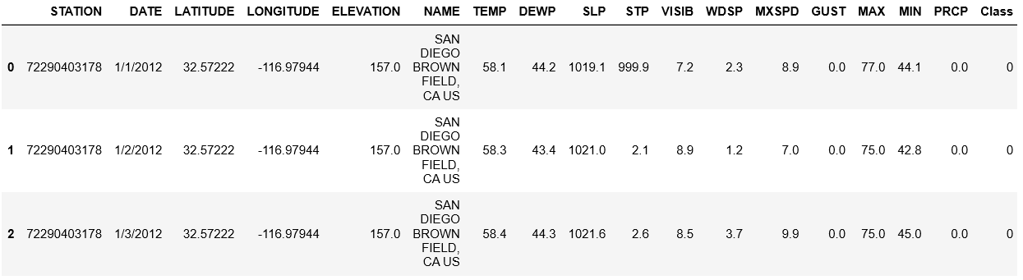
Dataset study - Weather
Frequency - Daily
Data History - 2011 - 2018
DataSource: NCEI (National Center for environmental information): https://www.ncei.noaa.gov/data/global-summary-of-the-day/access/

Slide 10

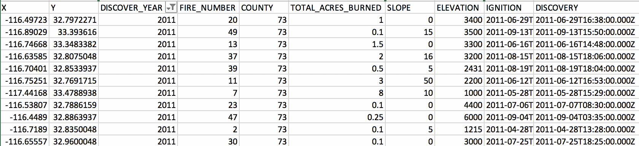
Dataset study - Fire History
Frequency - Daily
Data History - 2011 - 2018
DataSource: https://frap.fire.ca.gov/

Slide 11

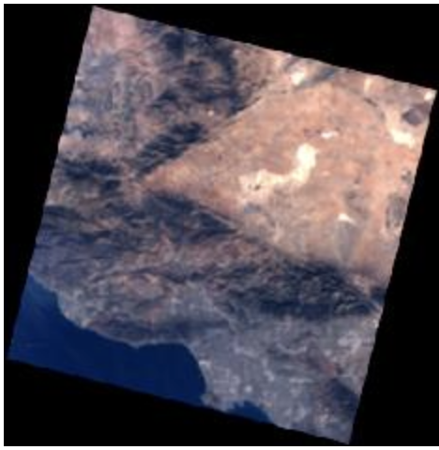
Dataset study - Remote Sensing Data
Landsat 8 data with 11 bands
Data History - 2013 - 2020
Data Format - Shapefile, KML and CSV
30m resolution and 16-day revisit duration.
Path: 40, 41
Row: 37, 36
LandSat 8
LandSat 7 ETM+ (Terra)
BAND 2 - Visible Blue
BAND 6 - Short Wavelength Infrared (SWIR 1)
BAND 3 - Visible Green
BAND 7 - Short Wavelength Infrared (SWIR 2)
BAND 4 - Visible Red
BAND 10 - Thermal Infrared
BAND 5 - Near Infrared (NIR)

Slide 12
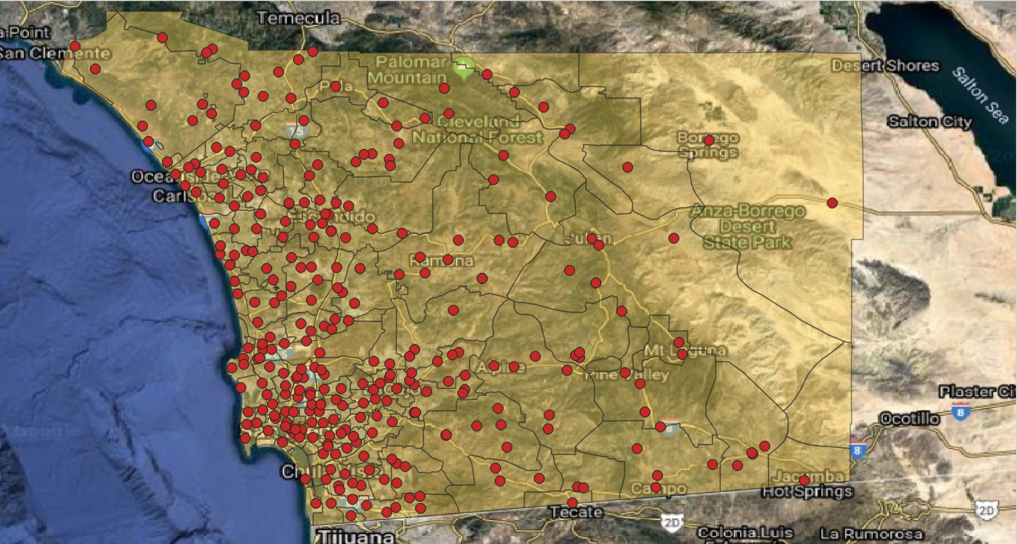
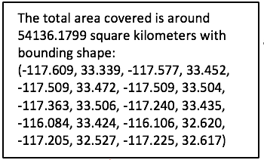
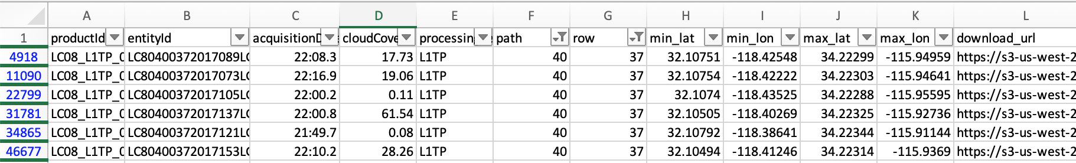
Dataset study - Remote Sensing Data
AWS open registry - Accessing Landsat 8 TIFF images.
The scene size: 170 km x 185 km (106 mi x 115 mi).

Slide 13

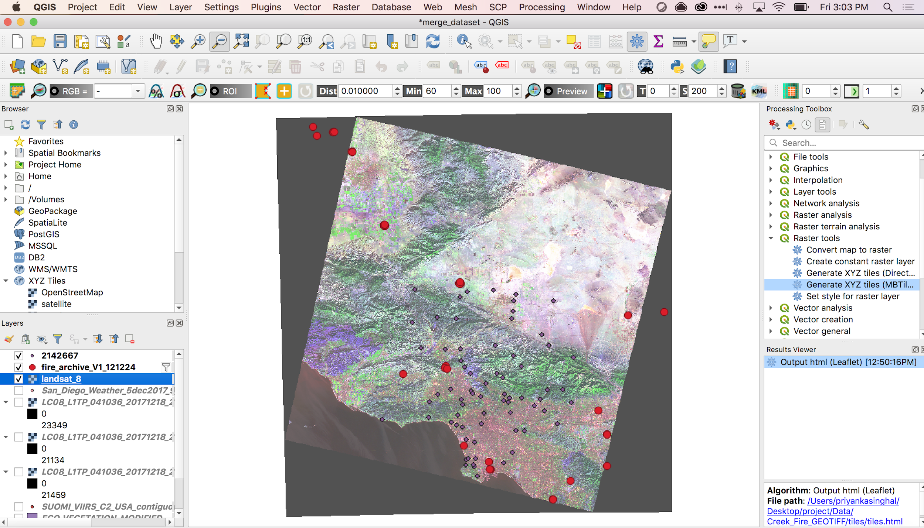
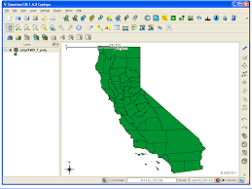
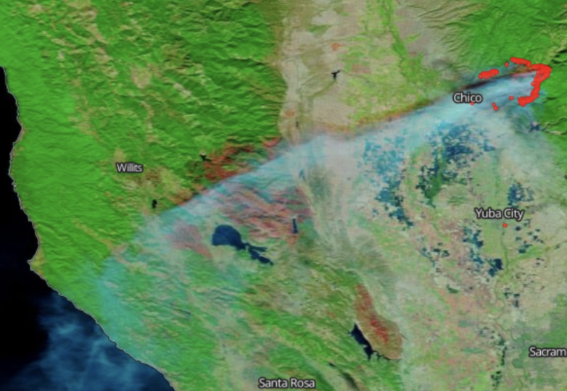
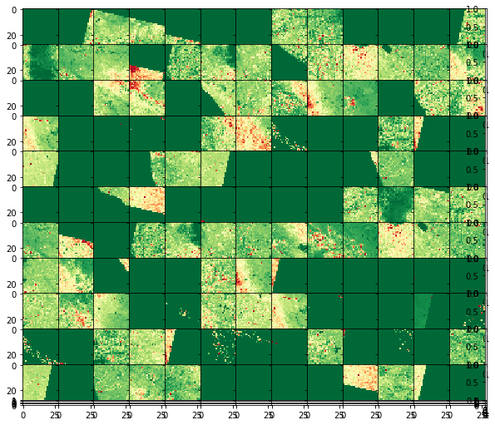
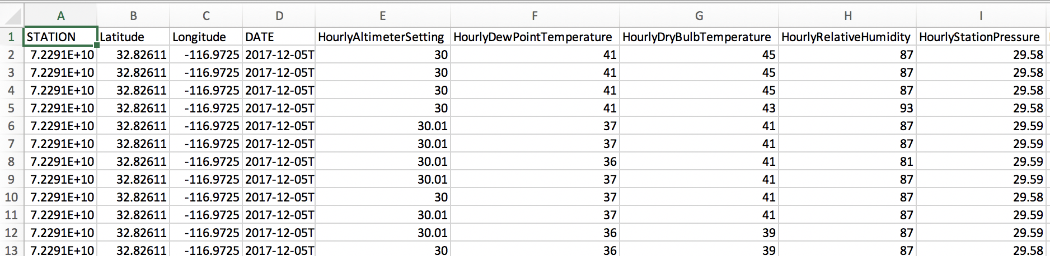
Data Pre-processing
Fig. Data Transformation
Shapefile
Fig. Overlaying datasets using ArcGIS
Fig. Data Correction and Reduction- Missing values
Fig. Geotiff Tiling

Slide 14
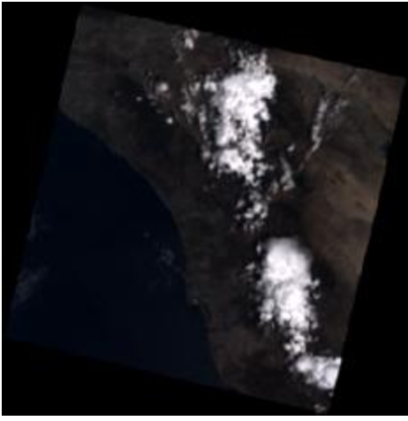
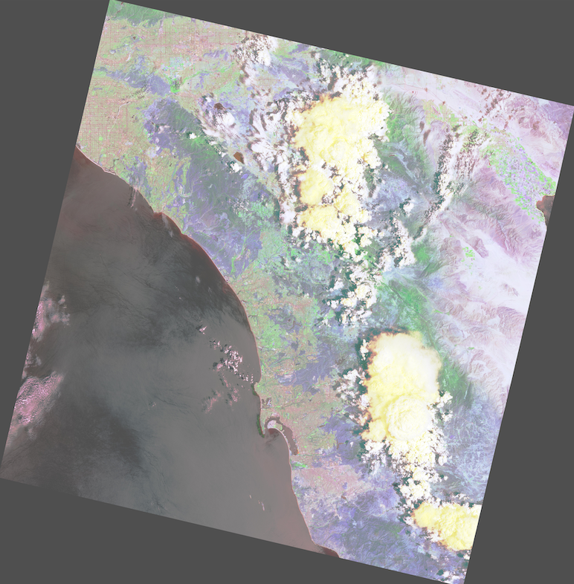
Data Pre-processing - Atmospheric Correction
Filtered the data with cloud-cover
Performed atmospheric correction to correct reflectance errors as per below formula
Correction = Mp * ds + Ap
Mp, Ap : scale factors from remote sensing metadata file
Used Rasterio library of Python for processing images
Raw Geotiff Image
Preprocessed image

Slide 15
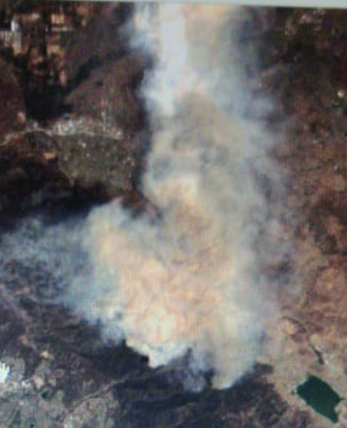
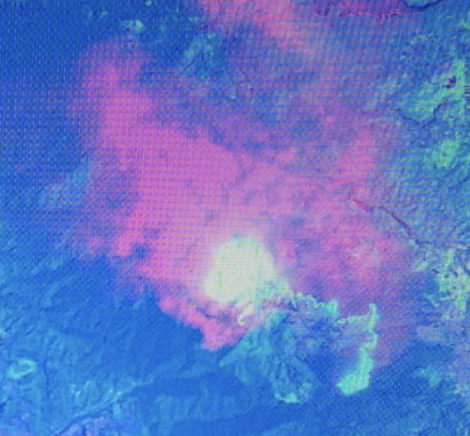
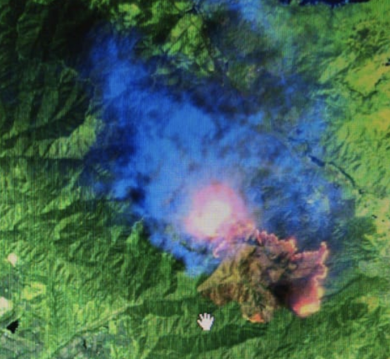
Data Pre-processing - Satellite Bands
BAND 2, 3, 4
BAND 4, 7, 10
BAND 4, 6, 7
Band 2 - Blue band Band 5 - Near Infrared band
Band 3 - Green Band Band 6 - Short Wave InfraRed (SWIR1)
Band 4 - Red Band Band 7 - Short Wave InfraRed (SWIR2
Band 10 - Thermal Band

Slide 16
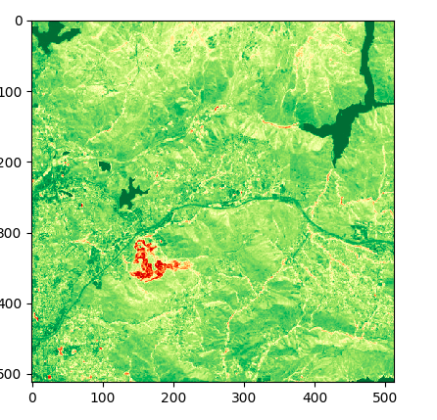
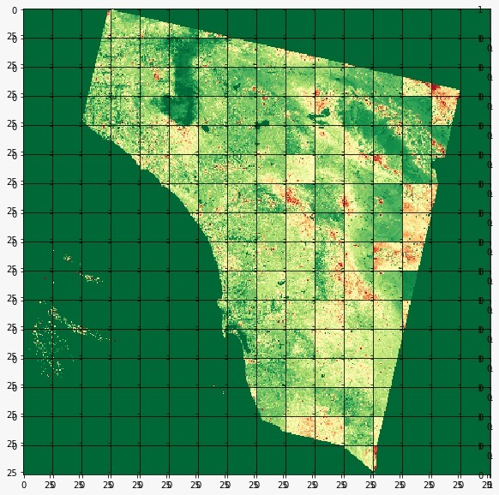
Data Pre-processing - GeoTiff Tiling using rasterio
Fig. Smaller tiles of entire area of study
Fig. Area of study divided into grids of tiles
The scene image dimensions: 7691 x 7821 pixels
One block (geoTiff tile) size: 512 x 512 pixels
Area covered by the entire raster image on ground: 230.73km x 234.63km
The area covered by one GeoTiff tile: 14km x 14 km roughly.

Slide 17
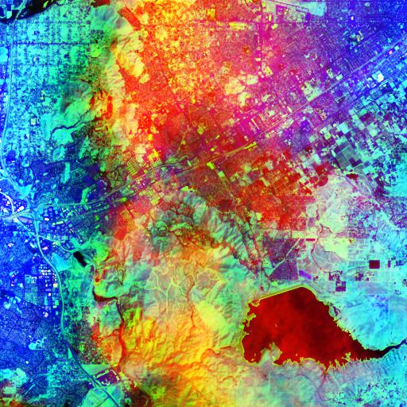
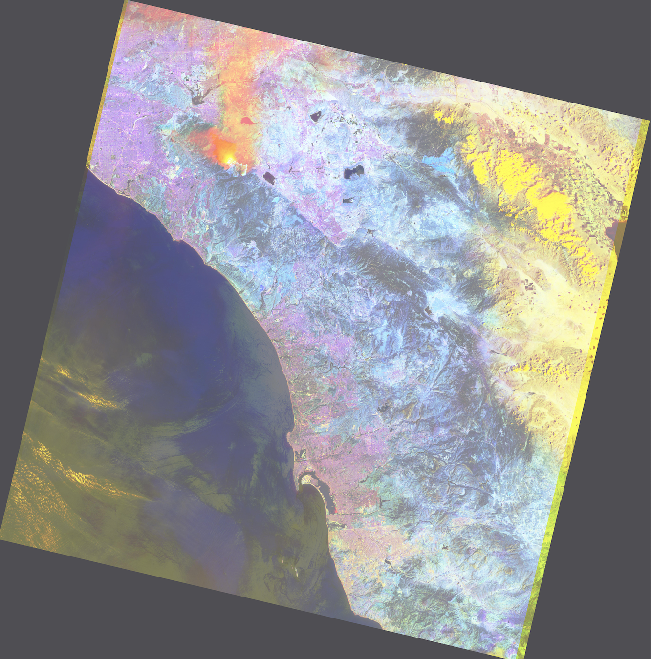
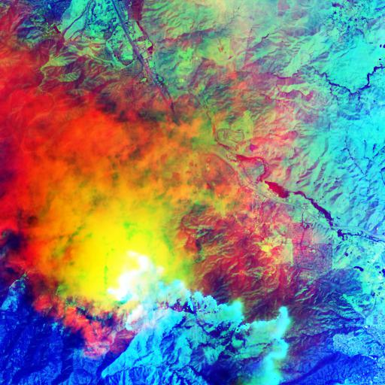
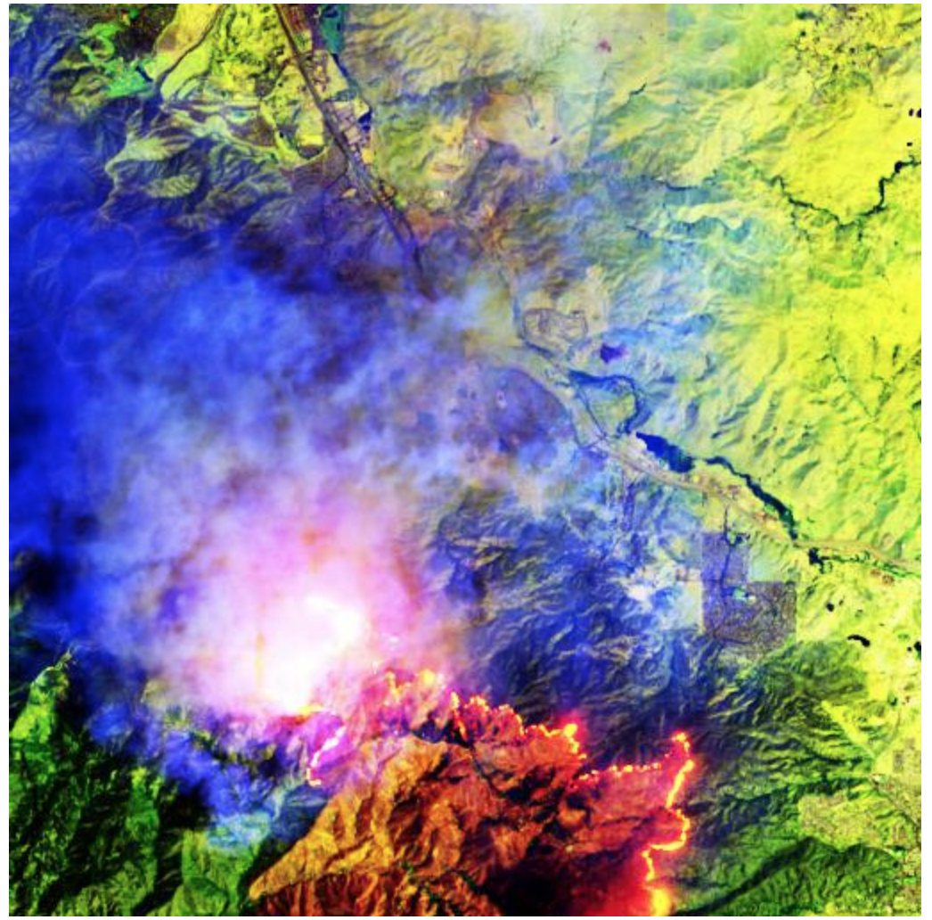
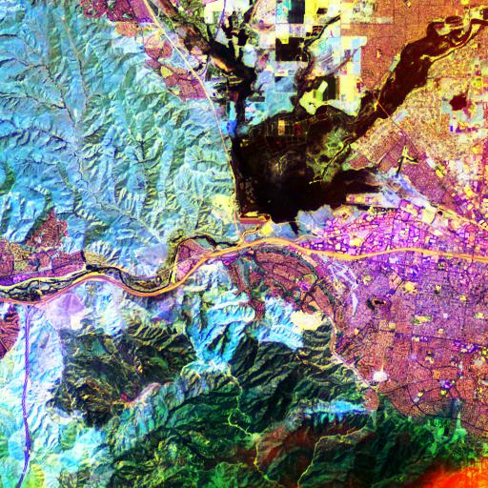
Data Preprocessing - Band Overlay and Tiling
Fig. Depiction of the tile with active fire (14Km x 14Km area).
Fire picture obtained by overlapping different bands on Landsat 8 image
Fig. Depiction of the tiles surrounding active fire
(14Km x 14Km area)
Fig. Processed GeoTiff image depicting active fire

Slide 18
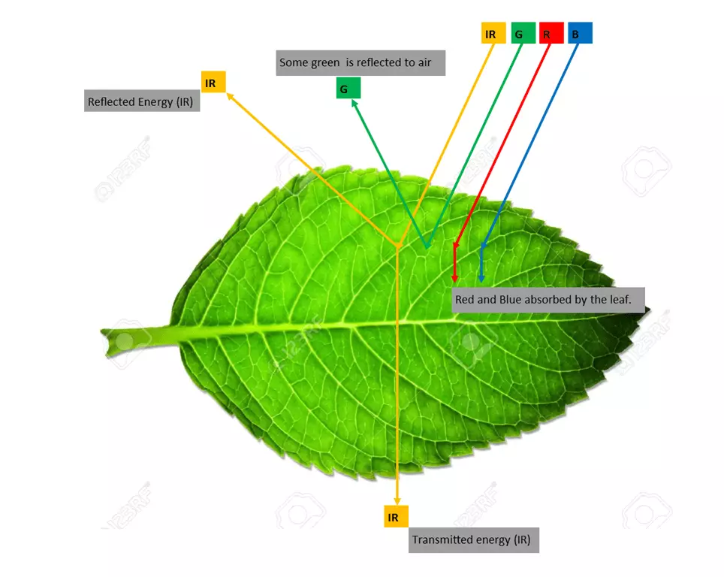
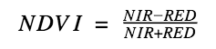
Data Preprocessing – Vegetation Data (NDVI Statistical Analysis)
Land Cover Type | NDVI
Dense vegetation | 0.7
Dry Bare Soil /No vegetation | 0.025
Cloud | 0.002
Snow and ice | -0.046
Water | -0.257
NDVI value and the corresponding land cover type.
NDVI (Normalized Differential Vegetation Index) is the indicator of vegetation and land cover. It indicates the amount of chlorophyll color reflected from one area.
NDVI is calculated using two bands from the remote sensing data.
NIR - Near Infrared band
RED - Red band

Slide 19
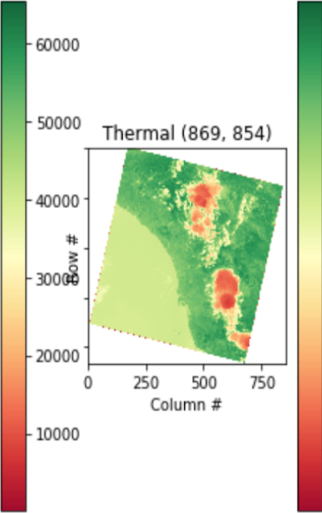
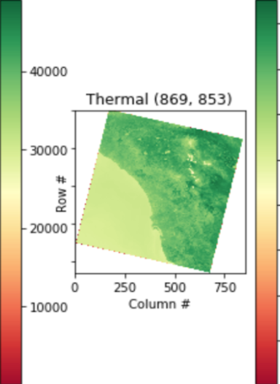
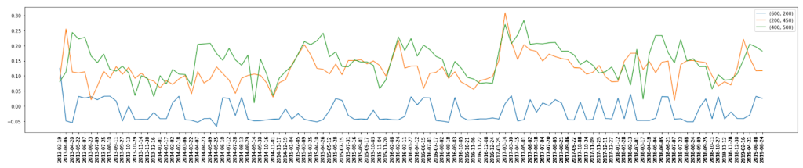
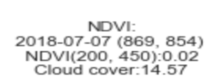

Statistical Analysis - Fire Risk Index - NDVI
Plot of NDVI value vs date. Statistical analysis of NDVI values around the year shows that during wildfire, the NDVI value drops considerably creating deep valleys in the plot. By connecting this to fire history, machine learning models can predict fire risk.
Fire
Post Fire
Fig. NDVI image during fire and after fire, when the vegetation grows back.

Slide 20
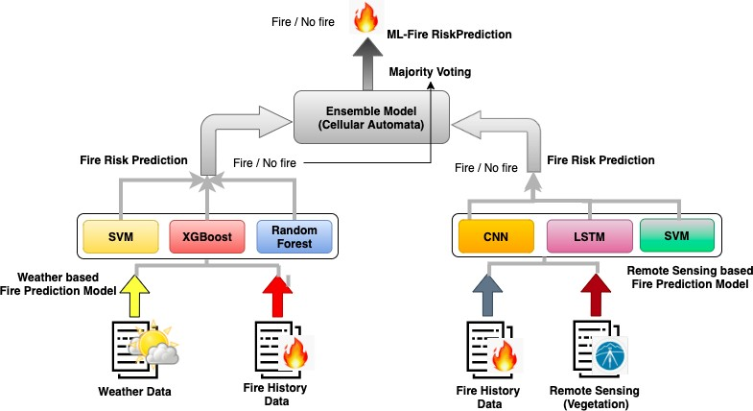
Fire Risk Prediction Models
Fig. Ensemble model architecture for Fire Risk Prediction (Right hand side shows the weather-based fire prediction model and Left-hand side shows remote sensing-based fire prediction model)

Slide 21
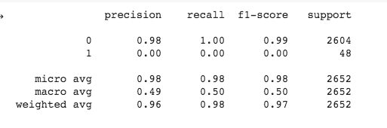
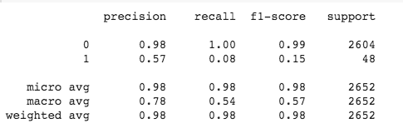
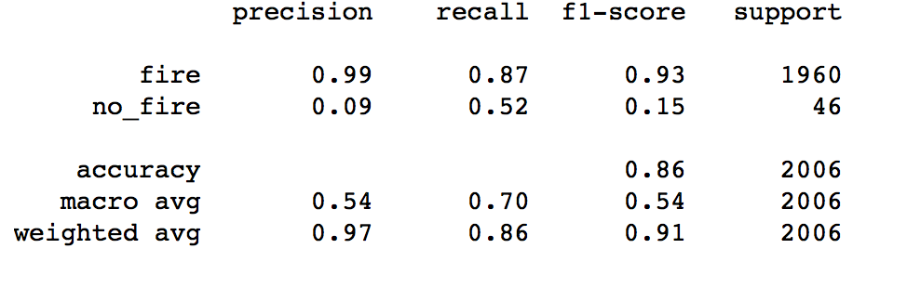
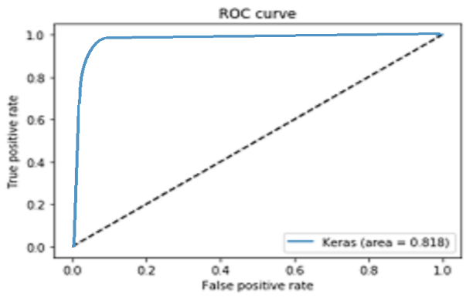
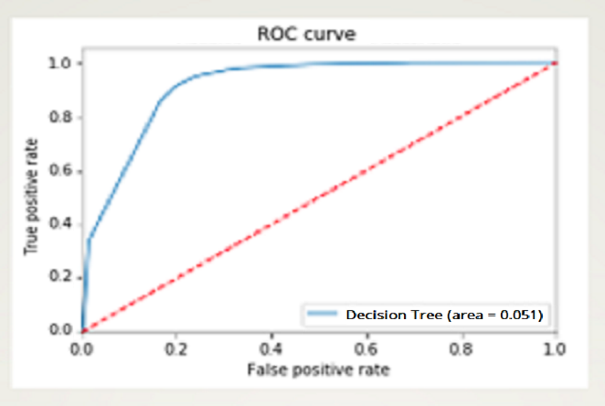
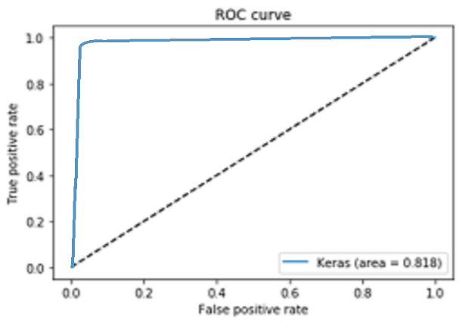
Results - Weather Model : Fire Risk Prediction
SVM XGBoost Random Forest
Fig. ROC Curve for SVM
Fig. ROC Curve for XGBoost
Fig. ROC Curve for RF

Slide 22
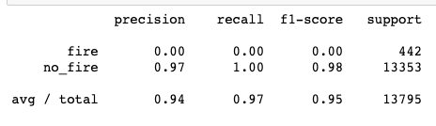
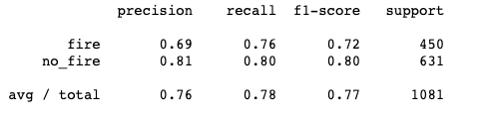

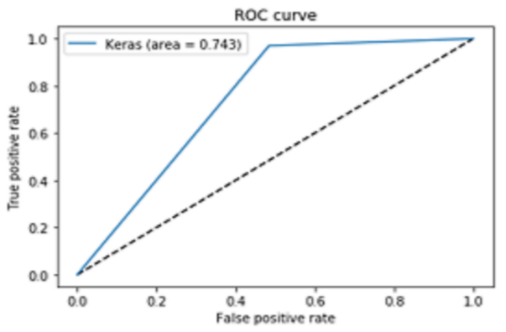
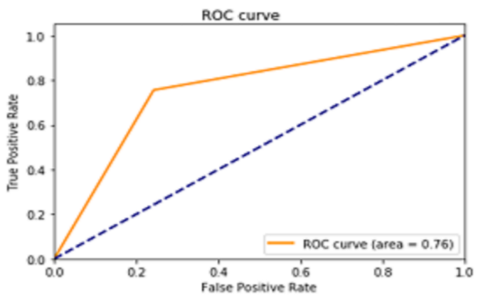
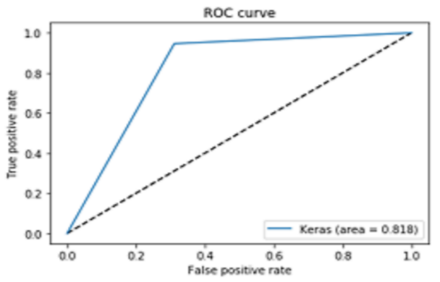
Results - Remote sensing : Fire Risk Prediction
CNN MLP LSTM
Fig. ROC Curve for CNN
Fig. ROC Curve for MLP
Fig. ROC Curve for LSTM

Slide 23
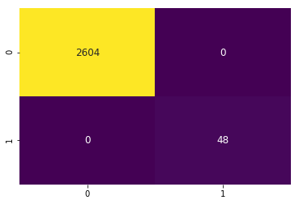

Results - Ensemble model : Fire Risk Prediction
Ensemble Model Results
 | Model | Recall | Precision | F1-Score
Weather based Fire Risk Prediction Model | SVM | 98.18% | 96% | 97%
 | XGBoost | 98.23% | 98% | 98%
 | RF | 97.54% | 99% | 91%
Remote Sensing based Fire Risk Prediction Model | CNN | 96% | 94% | 94.5%
 | LSTM | 97% | 94% | 95%
 | MLP | 73% | 73% | 73%
Ensemble Model for Fire Risk Prediction | Cellular Automata | 100% | 100% | 100%
Confusion matrix for ensemble model
ROC curve - 99.9 % accuracy

Slide 24

Fire Detection Model
Fig. Architecture of Faster R-CNN model to predict fire detection.

Slide 25



Model Evaluation - Fire Detection
Fig. Fire detection on a specific tile of 14x14 km area
Fig. (a) Model accuracy and (b) Model loss for fire detection using Faster R-CNN model

Slide 26

Different Models and Comparisons
Data Dimension | Model | Recall | Precision | F1 score
Weather based Fire Risk Prediction Model | SVM | 98.19% | 96% | 97%
 | XGBoost | 98.23% | 98% | 98%
 | Random Forest | 97.54% | 99% | 91%
Remote Sensing based Fire Risk Prediction Model | CNN | 96% | 94% | 94.5%
 | LSTM | 97% | 94% | 95%
 | Multilayer Perceptron | 73% | 73% | 73%
Ensemble Model for Fire Risk Prediction | Cellular Automata | 100% | 100% | 100%
Fire Detection | Faster R-CNN | 93% | 80% | 86%

Slide 27
Conclusion
In our research, we have explored the effect of various types of data to study fire risk prediction and detection using machine learning approaches.
Unlike other research that examines either fire risk detection or fire risk prediction with limited data and parameters, our work focuses on understanding these concepts using past fire events, weather, remote sensing, and satellite data.
We obtained the cut-edge accuracy of 100% with our ensemble model for fire risk prediction and 93% for fire risk detection.
In the future, we plan to develop a real-time intelligent fire system that can provide information about the fire risk prediction, detection, and fire spread pattern.

Slide 28
Thanks!

